Slide 1
Naming Service
A naming service maintains a set of bindings. Bindings relate names to objects. Clients use the naming service to locate objects by name.

Slide 2
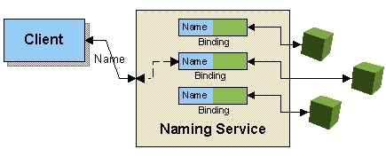
Naming Service
In order to be a naming service, a service must at the very least provide the ability to bind names to objects and to look up objects by name.

Slide 3
Some of the Naming Services available
COS (Common Object Services) Naming
The Common Object Services (COS) Name Server is the name server for storing Common Object Request Broker Architecture (CORBA) object references.
DNS (Domain Name System)
Domain Name System (DNS) is a directory service that provides a mapping between the name of a host on the network and its numerical address.
LDAP (Lightweight Directory Access Protocol)
Lightweight Directory Access Protocol (LDAP) is a client/server protocol used to access and manage directory information.
NIS (Network Information System) and NIS+
Developed by Sun Microsystems. Both allow users to access files and applications on any host with a single ID and password.

Slide 4
JNDI
The Java Naming and Directory InterfaceTM (JNDI) is an application programming interface (API) that provides common way of accessing variety of directories(new, emerging, and already deployed). i.e. client can access any directory service/s using JNDI without worrying about their internal implementation.

Slide 5
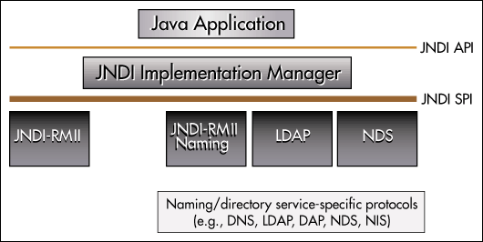
JNDI

Slide 6
JNDI API
Context and InitialContext
Here Context is an interface and InitialContext is its implementation.
Some of the methods are :
void bind(String stringName, Object object): Binds a name to an object. The name must not be bound to another object. All intermediate contexts must already exist.
Object lookup(String stringName): Returns the specified object.

Slide 7
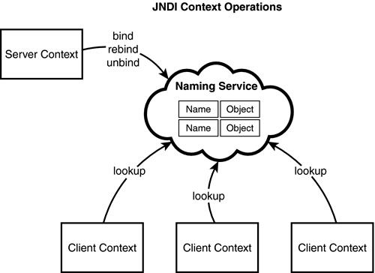
How does JNDI work?

Slide 8
java:comp:env
1) you need to configure datasource implementation with some name e.g. "jdbc/mypool" on the Web server or Application Server.
2) when the application server /container starts, the JNDI service will store a reference to the datasource under the java:comp/env/ namespace
3) your applications can simply look up the data source implementation for obtaining a connection to the database, to which the data source implementation is pointing to.

Slide 9
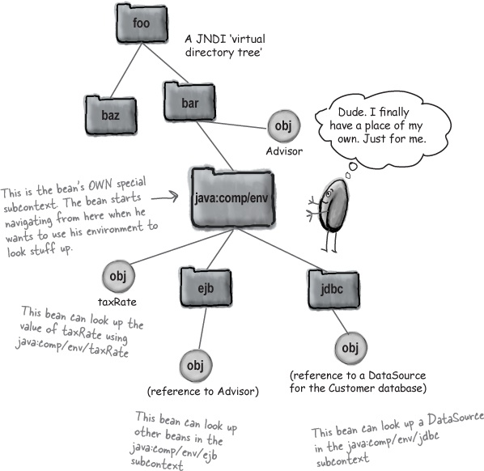
java:comp:env

